Slide 1


Contemporary Grammar of English
4th Year
Assist. Lect. Abbas Muhsin Al-Maliki
Department of English

Slide 2
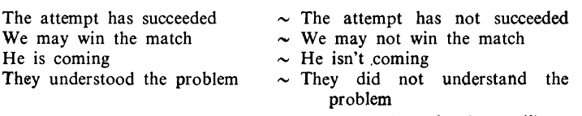
7.33 Negation
1. The negation o f a simple sentence is accomplished by inserting not, n’t between the operator and the predication:

Slide 3
7.33Negation
2. Sentences with lexical be behave exactly as when be is auxiliary:
She is a teacher. = She isn't a teacher.
3. Lexical have usually has do as operator (though in BrE it often need not, and informally got is often added):
He has enough money = He doesn’t have enough money (esp AmE)
He hasn’t (got) enough money (esp BrE)

Slide 4
7.34 Abbreviated Negation
In circumstances where it is possible to abbreviate the operator by the use of a contracted form enclitic to the subject (usually only a pronoun), two colloquial and synonymous forms of negation are possible:
He isn’t coming We aren’t ready They haven’t caught him She won’t miss us He wouldn’t notice anything | He’s not coming We’re not ready They’ve not caught him She’ll not miss us He’d not notice anything

Slide 5
7.35 Non-Assertive Forms
There are numerous items that do not naturally occur outside negative, interrogative, and conditional clauses; for example:
We haven’t seen any soldiers (Right)
*We have seen any soldiers (Wrong)

Slide 6
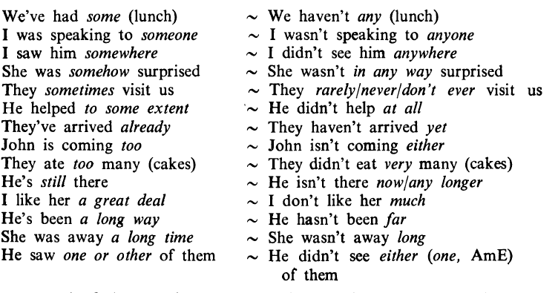
7.35 Non-Assertive Forms
These items (which may be determiners, pronouns, or adverbs) are the non assertive forms, and the following examples will illustrate their range:

Slide 7
7.35 Non-Assertive Forms
In several o f the negative sentences, the negative particle and the nonassertive form can combine to produce a negative form {ever- never) or can be replaced by a negative form:
Have you ever been to England? I have never been to England.
Has she ever met the Prime Minister? She has never met the Prime Minister.
He hadn't anything =He had nothing.

Slide 8
7.36 Negative intensification
1. There are various ways of giving emotive intensification to a negative.
by any means and a bit (informal) as common alternative to at all non-assertive expressions of extent.
2. Negative determiners and pronouns are given emphasis by at all, whatever :
I found nothing at all the matter with him.
You have no excuse whatever.
3. Never is repeated for emphasis: I’ll never, never go there again;
or else combined with an intensifying phrase such as in {all) his/her etc life:
I have never in all my life seen such a crowd.

Slide 9
7.37 Alternative negative elements
Instead of the verb, another element my be negated:
  An honest man would not lie. No honest man would lie.
  I didn’t see any birds. I saw no birds.
The scope of negation is however frequently different, so that:
Many people did not come. does not mean the same as
Not many people came (Few people came’)
3. When negative adjuncts are made initial there is inversion of subject and operator:
I will never make that mistake again.
Never again will I make that mistake (formal)

Slide 10
7.38 MORE THAN ONE NON-ASSERTIVE FORM
If a clause contains a negative element, it is usually negative from that point onward. This means that the non-assertive forms must normally be used in place of every assertive form that would have occurred in the corresponding positive clause:
  I’ve never travelled anywhere by air yet
  I haven’t ever been on any of the big liners, either.
  No one has ever said anything to either of us.
  Not many of the refugees have anywhere to live yet.
2. The non-assertive forms even occur in positive subordinate clauses following a negative in the main clause:
Main Clause Subordinate Clause
Nobody has promised that any of you will be released yet
Main Clause Subordinate Clause
That wouldn’t deter anyone who had any courage

Slide 11
7.39 ‘Seldom’, ‘rarely’, etc
There are several words which are negative in meaning, but not in appearance. They include:
seldom and rarely
scarcely, hardly, barely
little and few (in contrast to the positive a little and a few)
Only
B. They have the following similarities to the ordinary negative items:
(1) They are followed by non-assertive rather than assertive forms:
  I seldom get any sleep ‘
  I ’ve spoken hardly anyone who disagrees with me
  Few changes in government have ever taken so many people
  by surprise
  Only two of us had any experience at sailing

Slide 12
7.39 ‘Seldom’, ‘rarely’, etc
(2) When in pre-subject position, some of them can cause subject operator inversion:
Rarely does crime pay so well as Mr Jones seems to think
Scarcely ever has the British nation suffered so much obloquy
Little need I dwell upon the joy of that reunion

Slide 13
(3) They are followed by positive rather than negative tag-questions:
She scarcely seems to care, does she?
In addition, there are verbs, adjectives, or prepositions with negative meaning that take non-assertive forms:
He denies I ever told him. Without any delay
I forgot to ask for any change. Against any changes
Unaware of any hostility

Slide 14
7.40 Scope of Negation
1. The operator is sometimes within, and sometimes outside, the scope.:
I definitely didn’t speak to him (‘It’s definite that I did not’)
I didn’t ’t definitely speak to him (‘It’s not definite that I did’)

